Slide 1
Inventory Tracker and Helper (TIAH)
By: Mitch Porter, Pedro Ochoa, Ethan Amundson, Kadar Yusuf

Slide 2
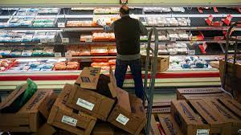
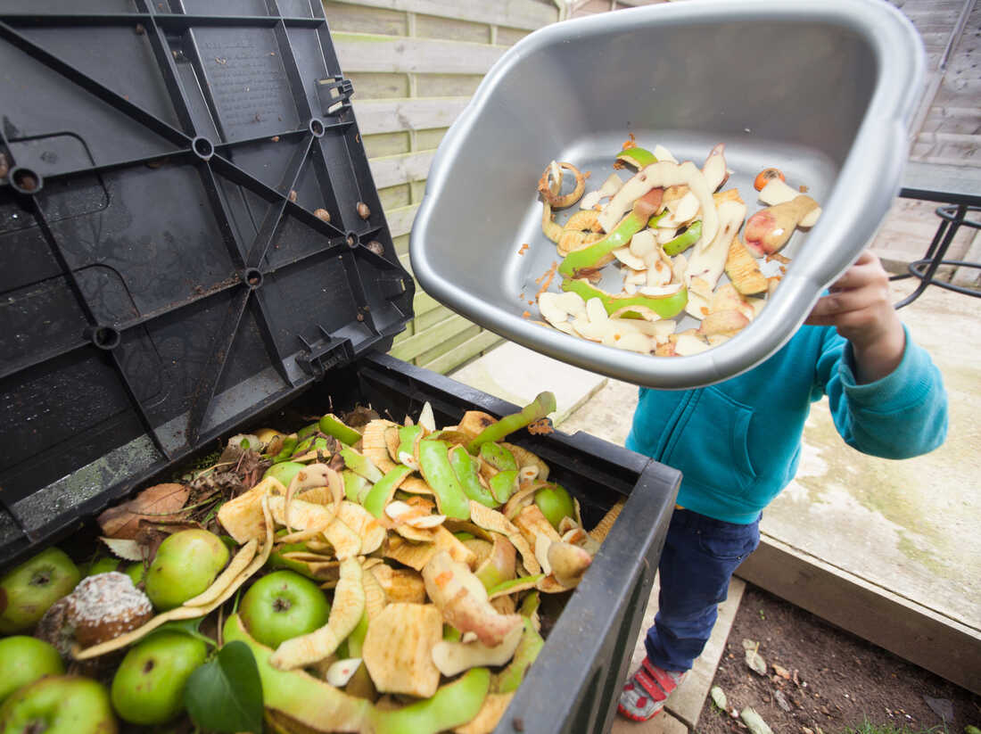
Executive Summary
Grocery stores and Gas stations purchase tons of product in an attempt to sell it to customers. But do they sell everything?
No. The grocery stores and gas stations throw away their expired food and unused product, and it all goes to waste.
Purpose of our project
Help grocery stores or gas stations minimize purchasing unused product that goes to waste
Important
To save money.
Reduce plastic use

Slide 3
Background & Problem History
In the United States, between 30 to 40 percent of food produced is wasted.
Americans throw away almost twice as much food as any other developed country.
Total food loss is valued at $218 billion in the United States as to $31 billion in Canada.
18 to 28 percent of our viable cropland is used for growing wasted food.
The USDA estimates that about 4 percent or 66,500 acres of planted crops are left unharvested each year.
A study in Minnesota found that up to 20 percent of fruits and vegetables are too large, small, or don’t otherwise meet cosmetic standards, and thus aren’t viable.
30% of a grocery store’s trash is food waste.
10 percent or 43 billion pounds of food in grocery stores will never make it off the shelf. For produce, about 12 percent of fruit and 11.5 percent of vegetables are never sold.
According to Utah State University, The food waste began in the late 1800s and early 1900s. Because that's when food became commercialized and changed how Americans consume food.
According to a Michigan State University poll, 88% of Americans are trying to reduce food waste.
Food waste is 8% of the world's greenhouse gas emissions. So some things people have done is to handle the waste that is created correctly.
Some of it includes everything from recycling programs to giving restaurant scraps to animals.

Slide 4
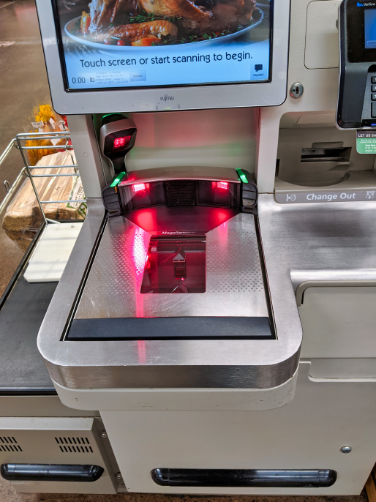
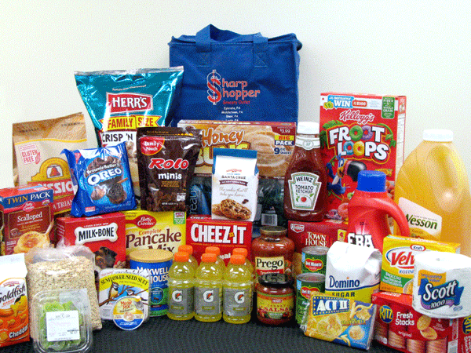
How is our project going to help solve the problem, and how is the solution unique?
Track amount of food purchased for store’s inventory
Help to see what is in demand or not
Will help check which items are low or not
Better than scanning all food by hand
Helper to prevent food waste
Electronically track the food

Slide 5
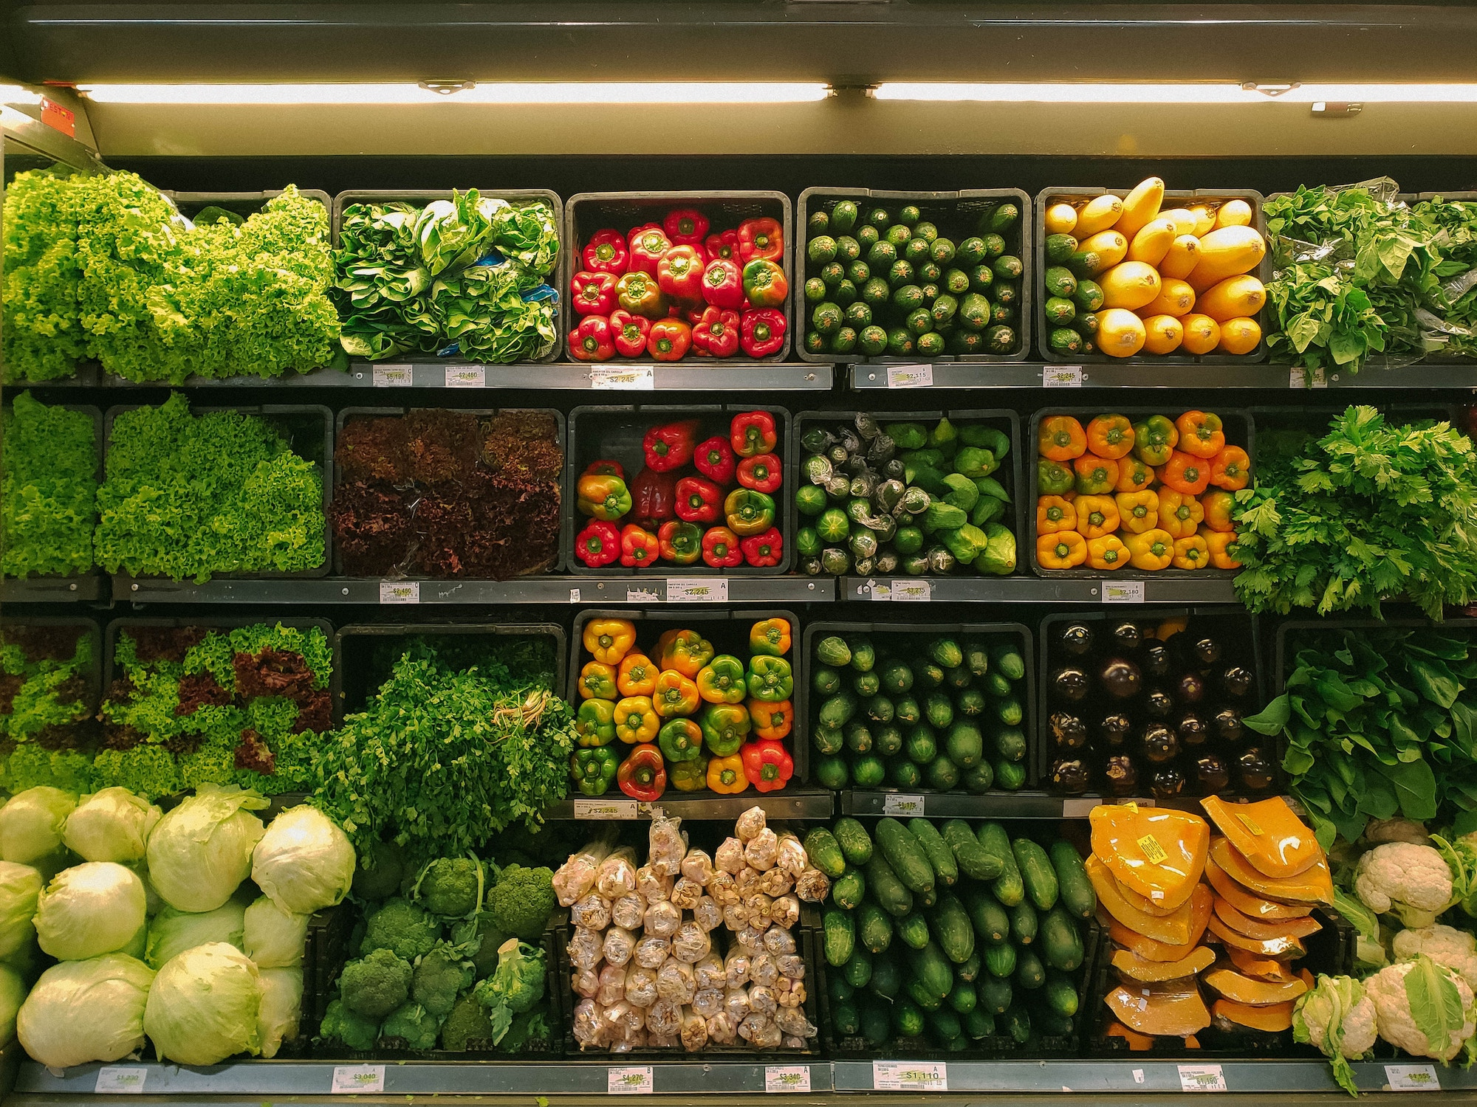
List of features and how they will help
Store inventory counter
A program that can track and count the different products in stock.
Overall store inventory document
Document that shows the excess products, or lack of products.
Telling us what is in demand and what is not.

Slide 6
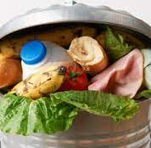
And how will we know that we helped…?
Our definition of success is that we save 90% of food from being thrown away by reducing the excess amounts of food grocery stores are buying.
This will save companies a lot of money and make a huge difference in food waste therefore helping our customers, environment and the planet as a whole.

Slide 7
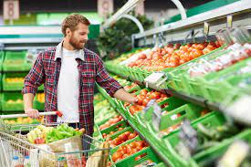
How to Start
We will require data sets of all the inventory including expiration dates.
Software to track the amount of sales for each item.
Pricing data for different items.

